Slide 1
Lecture 2
The Relational Data Model
CS4416

Slide 2
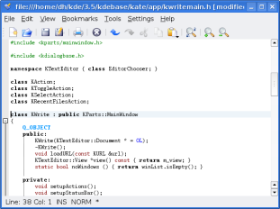
Database System
DBMS
Database
Application
Database
Database
Application
Database

Slide 3
Database System
DBMS
Conceptual
Data
Model
Physical Data Model
DDL, DML
Database
Database
Application
results, status
Database

Slide 4
What is a Data Model?
Notation for describing data or information:
Structure of the data: conceptual data model
Operations on data: queries, modifications
Constraints

Slide 5
Data Models
Conceptual data models
Entity-relationship
Relational
Hierarchical
Network
Graph
Key-value
Object-based
Document-based:
XML
JSON
Physical data models
Unifying model
Frame model

Slide 6
Relational Data Model
Based on the mathematical concept of a relation
Both entities and relationships are represented as tables
A relation is a table:
Attributes (column headers)
ID | Date of birth
100 | 1990-01-20
101 | 1980-12-12
Tuples
(rows)
Students
Relation name

Slide 7
Schemas
Relation schema = relation name and attribute list.
Optionally: types of attributes.
Example:
customers(ID, Date of birth)
customers(ID : string, Date of birth : date)
Database schema = set of all relation schemas in the database.
Database = collection of relations.

Slide 8
Why Relations?
Very simple model.
Often matches how we think about data.
Conceptual data model that underlies SQL, the most popular database language today.
Relations (plus the operations with relations) form an algebra – the relational algebra which has been very well studied by database theorists.

Slide 9
What is an “Algebra”
Mathematical system consisting of:
Operands - variables or values from which new values can be constructed.
Operators - symbols denoting procedures that construct new values from given values.

Slide 10
What is Relational Algebra?
An algebra whose operands are relations or variables that represent relations.
Operators are designed to do the most common things that we need to do with relations in a database.
The result is an algebra that can be used as a query language for relations.

Slide 11
Core Relational Algebra Operators
Union, intersection, and difference.
Usual set operations, but both operands must have the same relation schema.
Selection: picking certain rows.
Projection: picking certain columns.
Product: Cartesian product of two relations (considered as sets of tuples).
Renaming of relations and attributes.

